Slide 1
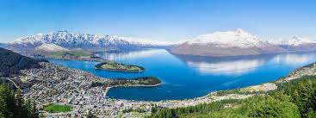
Introduction
New Zealand is a country southwestern of Pacific Ocean.
The country has a total population of 5 million and it is being classified as a developed country that ranks highly in international comparisons.

Slide 2
Business Problem
To recommend a location in New Zealand that is relatively densely populated with offices and is near to transportation. This will likely increase the human traffic which will translate to better business.
Introduction With the overall population in New Zealand, the aim is to locate the restaurant with good human traffic in a particular city to provide a good chance that the business will give better returns.
Data Description In this project, I will be using the data available on Wikipedia Link: https://en.wikipedia.org/wiki/List_of_cities_in_New_Zealand This data has provided several information that are crucial to determine the best location to start the restaurant operation. Important information such as population, population density, area size and etc.

Slide 3
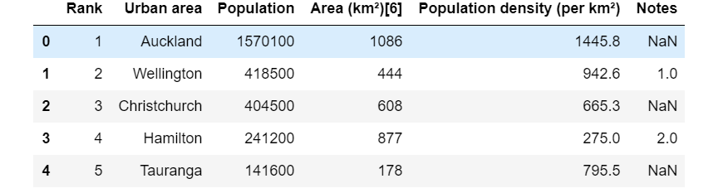
Objectives
The aim of this project is to identify the best location within the more densely populated urban area – Auckland. Among all the area in New Zealand, Auckland is the most densely populated area as shown in the table above. Thus, finding a suitable spot to locate the restaurant is crucial in order to provide a better opportunity for the business.

Slide 4
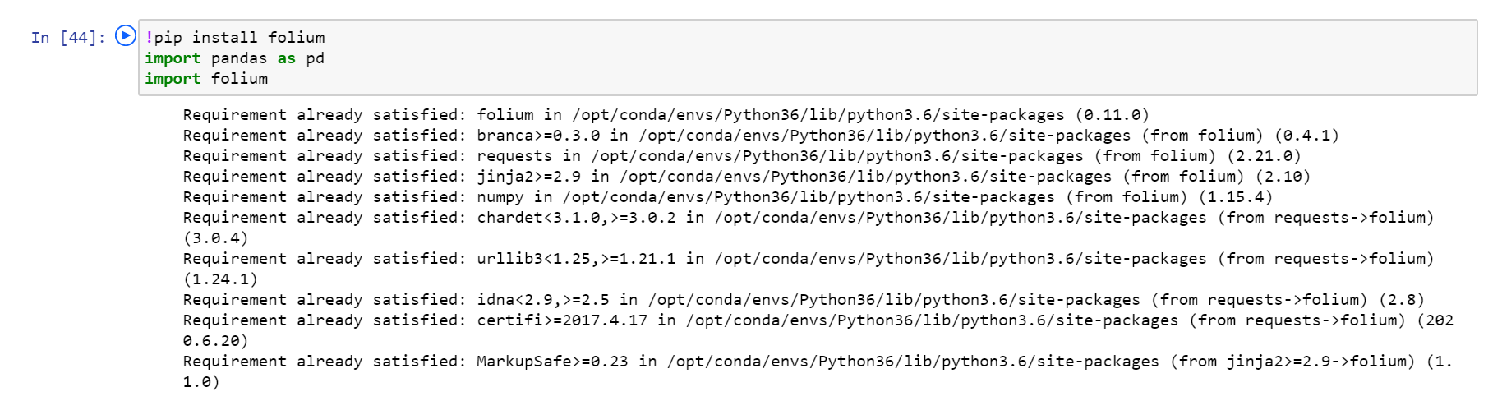
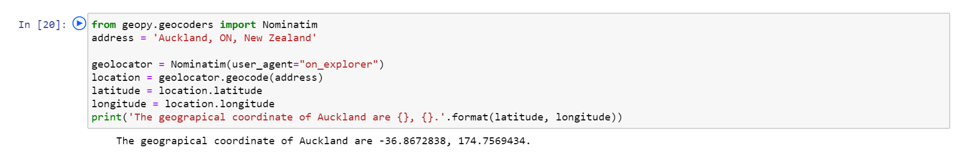
Methodology
The methodology includes the use of several libraries such folium and Nominatim to determine the coordinates of Auckland.

Slide 5
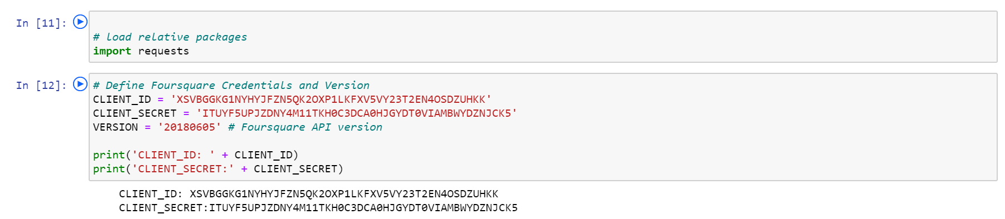
Methodology
This includes the creation of unique Client ID in order for coordinates to be retrieved through Foursqure API.

Slide 6
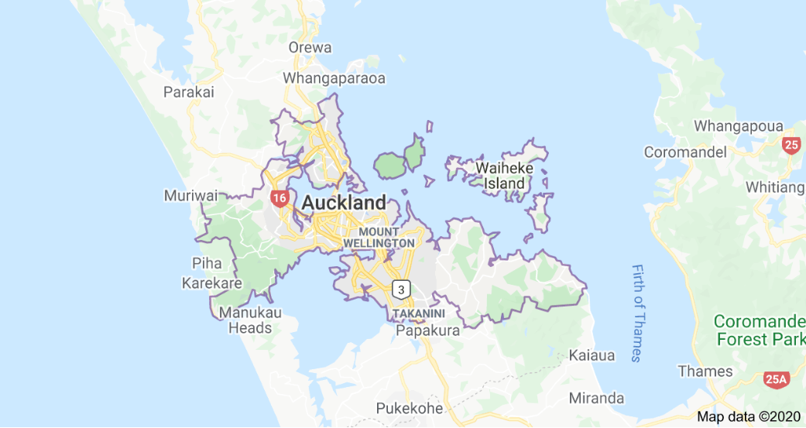
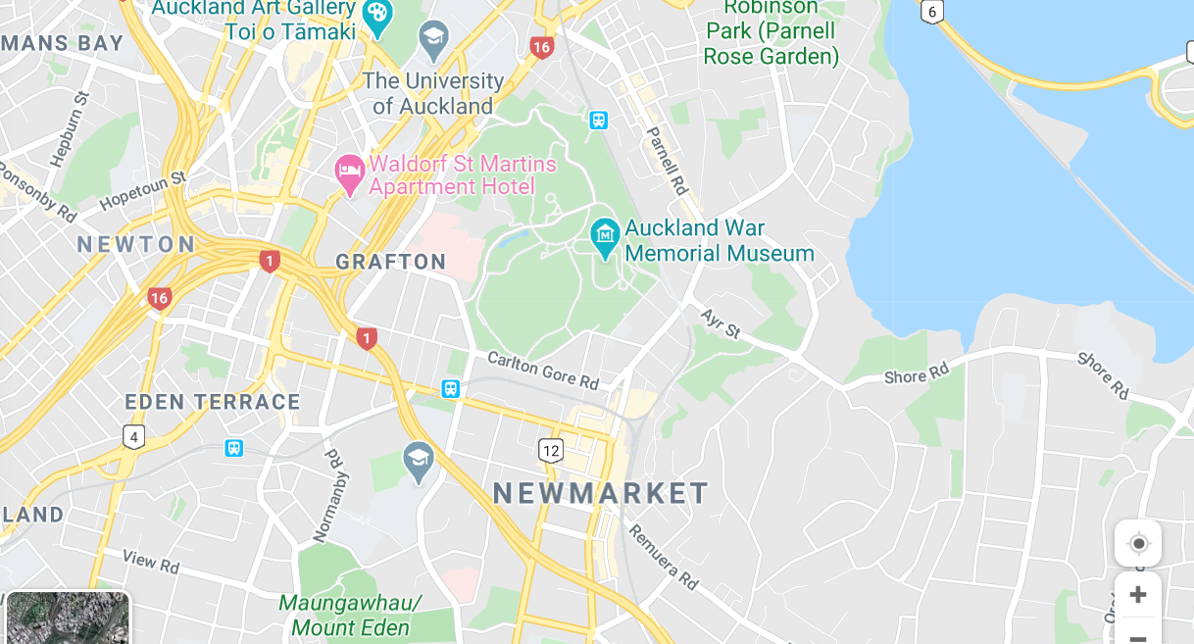
Results
Foursquare API is able to locate the coordinates which gives a better chance of success for the opening of a restaurant

